Slide 1
Programming for Cultural Data Analysis Instructor: Steve McLaughlin
Week 1
January 18, 2018

Slide 2
“For the moment and the foreseeable future . . . computers are essentially modeling machines, not knowledge jukeboxes . . .”
McCarty (2007). “Modeling: A study in words and Meanings”

Slide 3
Cultural Studies
Cultural studies is a field of theoretically, politically, and empirically engaged cultural analysis that concentrates upon the political dynamics of contemporary culture, its historical foundations, defining traits, conflicts, and contingencies . . . Cultural studies combines a variety of politically engaged critical approaches drawn including semiotics, Marxism, feminist theory, ethnography, critical race theory, Post-structuralism, Postcolonialism, social theory, political theory, history, philosophy, literary theory, media theory, film/video studies, communication studies, political economy, translation studies, museum studies and art history/criticism to study cultural phenomena in various societies and historical periods.
Wikipedia

Slide 4
Critical Data Studies
“Research and thinking that applies critical social theory to data to explore the ways in which they are never simply neutral, objective, independent, raw representations of the world, but are situated, contingent, relational, contextual, and do active work in the world”
Dalton, Craig, and Jim Thatcher. "What does a critical data studies look like, and
why do we care? Seven points for a critical approach to ‘big data’." Society and Space open site (2014).

Slide 5
How to be critical about data?
situate data regimes in time and space
expose data as inherently political and whose interests they serve
unpack the complex, non-deterministic relationship between data and society
illustrate the ways in which data are never raw
expose the fallacies that data can speak for themselves and that big data will replace small data
explore how new data regimes can be used in socially progressive ways
examine how academia engages with new data regimes and the opportunities of such engagement.
Dalton and Thatcher 2014

Slide 6
Humanities Computing
the computer is used as a tool for modeling humanities data and our understanding of it,
an activity entirely distinct from using the computer when it models the typewriter, or the telephone, or the phonograph, or any of the many other things it can be.
Unsworth, "What is Humanities Computing and What is Not?" 2002

Slide 7
What has counted as data in the humanities?
digitized editions of major works; transcriptions of manuscripts;
images of artworks (e.g., Rossetti, Blake, DeYoung Museum ImageBase); and
GIS Data
Linguistic features
Finding aids
Sperberg-McQueen, “Data Citation in the Humanities: What’s the Problem?” For Attribution -- Developing Data Attribution and Citation Practices and Standards: Summary of an International Workshop (2012).

Slide 8
Digitization
Image Scans
OCR’d text (Optical Character Recognition)
Dirty
Clean
Structured Data
SGML, XML, HTML
Tabular data (CSV, MySQL)
JSON

Slide 9
Modeling happens all the way down
Digitized Text
Structured Data
Ingest
Algorithms
Output
Scholarship
Digitization
Tools
Interpretation

Slide 10
Critical Questions for Big Data in the Humanities
Big data: cultural, technological, scholarly phenomenon that rests on the interplay of
Technology maximizing comp power and algorithmic accuracy
Analysis drawing on large data sets to identify patterns to make economic, social, technical, legal claims
Mythology widespread belief that large data sets offer more intelligence, knowledge, truth, objectivity, accuracy
danah boyd & Kate Crawford (2012). “Critcal Questions for Big Data.”
Information, Communication & Society, 15:5, 662-679

Slide 11
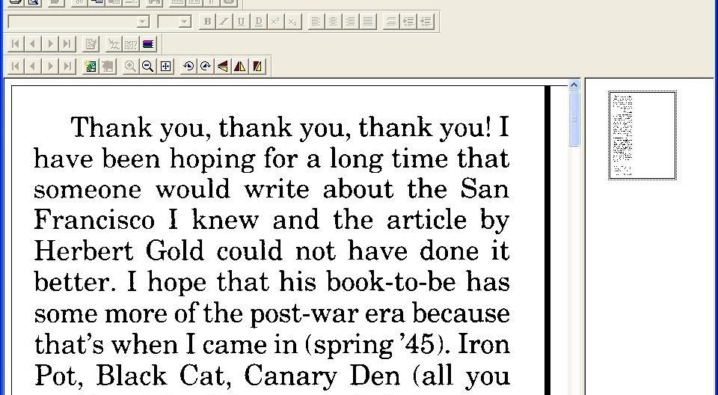
Certainly OCR isn’t modeling?

Slide 12
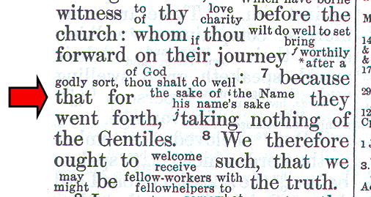
Not so easy to OCR

Slide 13
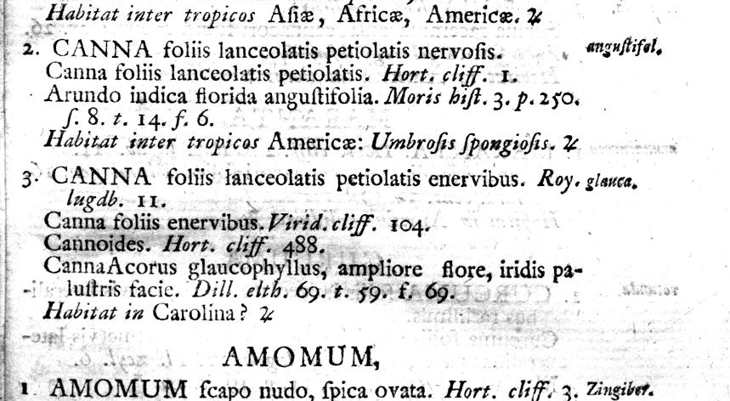
What kind of data do you capture?
http://biodiversitylibrary.org/page/358022#page/13/mode/1up

Slide 14
Humanities data: It’s not so free.
Copyright restrictions
We typically mine rather than create data.
Finding stuff to mine is hard.
We need help:
navigating APIs and visualizing datasets on the fly
with data modeling
need new data specifications – the *way* data is structured is inadequate
Posner 2015. Humanities Data: A Necessary Contradiction.

Slide 15
Critical Questions for Big Data in the Humanities
Big Data Changes the Definition of Knowledge
Reflects a computational turn in thought and research
Reflects a profound change in epistemology and ethics
Changes objects of study
Changes tools of study
Changes methods of knowing
danah boyd & Kate Crawford (2012). “Critcal Questions for Big Data.”
Information, Communication & Society, 15:5, 662-679

Slide 16
Critical Questions for Big Data in the Humanities
Claims to objectivity and accuracy are misleading
Made by subjects and based on situated and subjective observations and choices, each discipline has it’s own “data imagination” (Gitelman)
What is included
What is ignored
Data cleaning
How it is structured
danah boyd & Kate Crawford (2012). “Critcal Questions for Big Data.”
Information, Communication & Society, 15:5, 662-679

Slide 17
Example: HathiTrust Digital Library
13+ million volumes | 5+ million book titles |
29k serial titles | 3+ billion pages
Around 50% of volumes are in English | Many other languages included as well
Notes:
HathiTrust is a partnership of major research institutions and libraries working to ensure that the cultural record is preserved and accessible long into the future. There are more than 80 partners in HathiTrust, and membership is open to institutions worldwide.

Slide 18
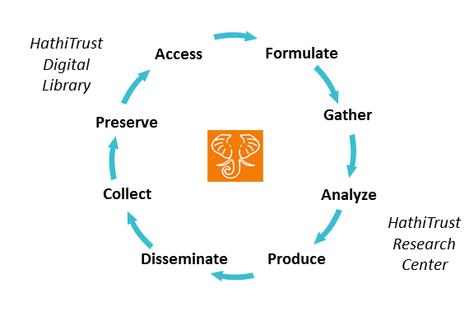
HathiTrust

Slide 19

HathiTrust
Digitized text
at scale
HathiTrust Research Center
Computational methods
Analysis
Notes:
Some note about scale that the HTRC brings

Slide 20
HTRC Algorithms …make more Data?
Extracted Features Rsync Script Generator
MARC Downloader
Meandre Classification Naive Bayes
Meandre Dunning Log-Likelihood to Tag Cloud
Meandre OpenNLP Date Entities to Simile
Meandre OpenNLP Entities List
Meandre OpenNLP Report per Volume
Meandre Tag Cloud
Meandre Tag Cloud with Cleaning
Meandre Topic Modeling
Simple Deployable Word Count

Slide 21
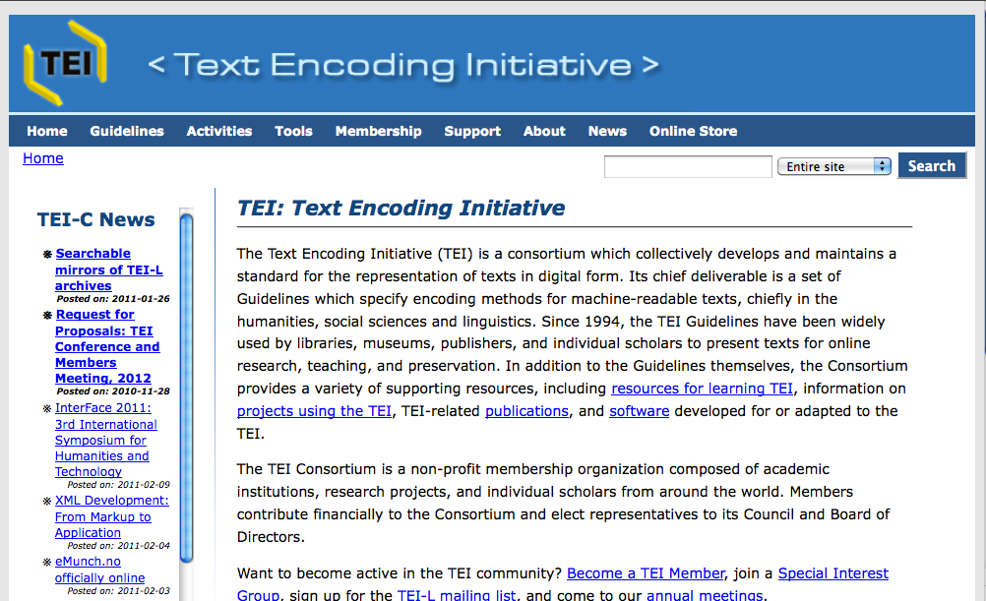
A DH Example of XML – made by people, for people
TEI: the rules awe are following
http://www.tei-c.org/

Slide 22
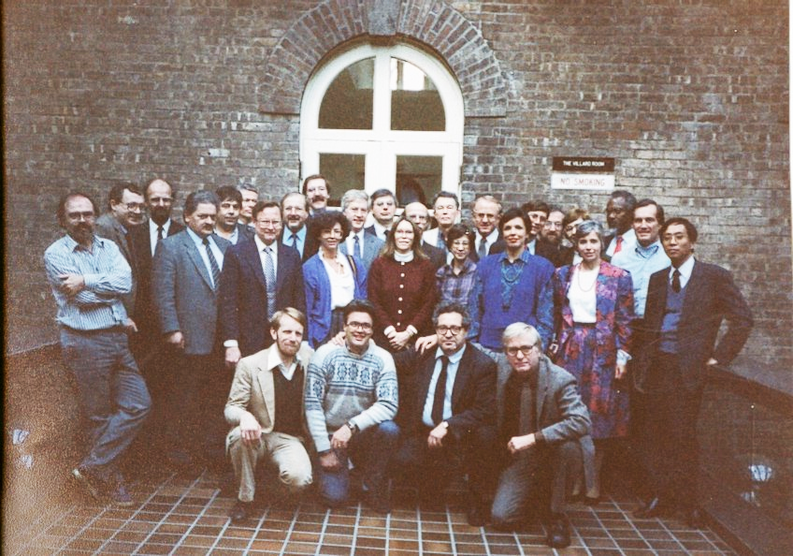
TEI: the rules we are following
Autumn 1987: NEH funds an exploratory international workshop on the feasibility of defining "text encoding guidelines”, Vassar College, Poughkeepsie

Slide 23
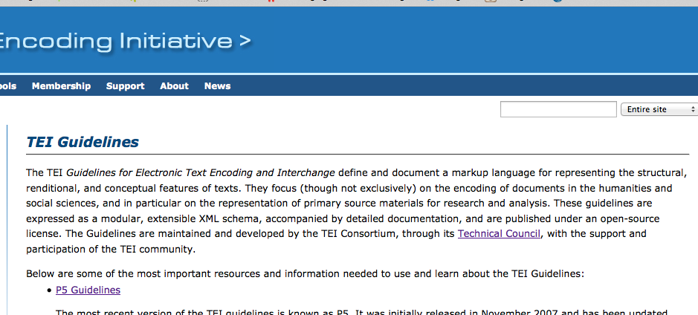
TEI: the rules we are following
http://www.tei-c.org/

Slide 24
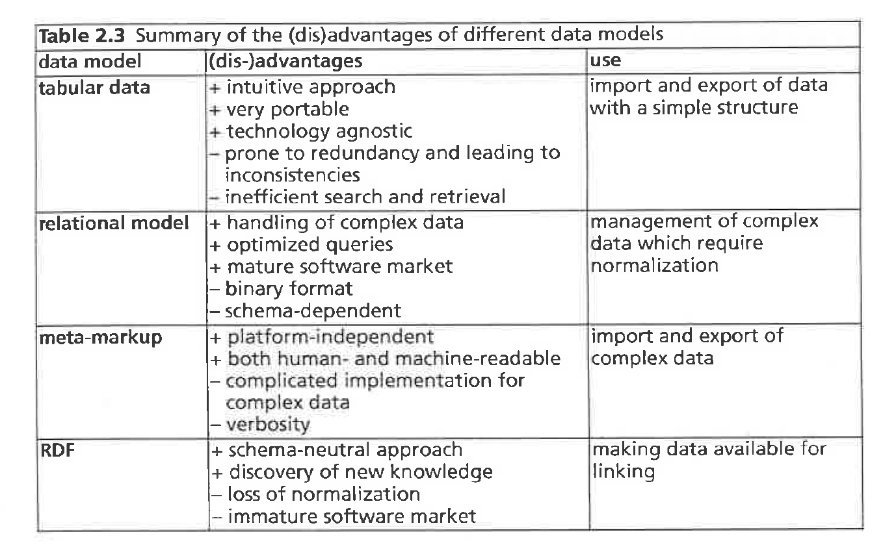
And, different data structures . . .
Hooland, Seth van, and Ruben Verborgh (2015). Linked Data for Libraries, Archives
and Museums: How to Clean, Link and Publish Your Metadata.

Slide 25
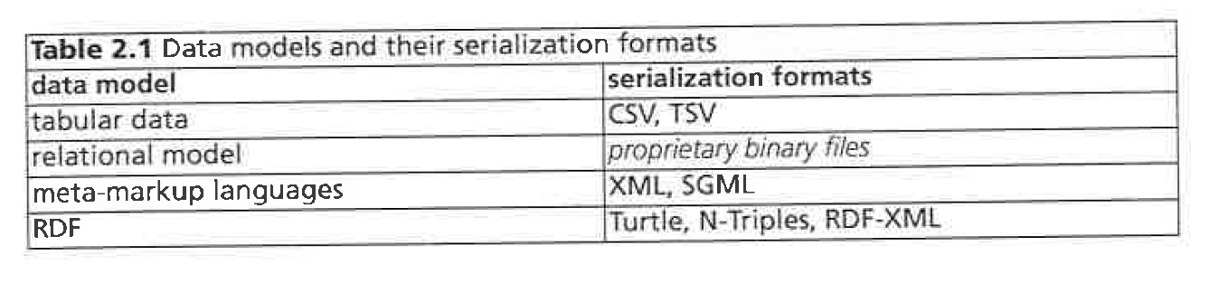
Data models and serialization formats
Hooland, Seth van, and Ruben Verborgh. [Chp1-2].Linked Data for Libraries, Archives
and Museums: How to Clean, Link and Publish Your Metadata. N.p., 2015.

Slide 26
HTML vs. XML vs. Json
HTML <h1>Moby Dick</h1> <h2>The Whale</h2>
XML: <titleStmt> <title>Moby Dick</title> <title type=“alt”>The Whale</title> </titleStmt>
JSON
{
"titleStmt": {
"title": [
"Moby Dick",
{
"_type": "alt",
"__text": "The Whale"
} ]
}
}

Slide 27
Critical Questions for Big Data in the Humanities
Bigger data are not always better data (what is a representative sample? )
Ethnographers focus on reflexively accounting for bias in their interpretations
Experimentalists control and standardize the design of their experiments
Survey researchers drill down on sampling mechanisms and question bias
Quantitative researchers weigh up statistical significance
What do Humanists do to establish rigor?
danah boyd & Kate Crawford (2012) CRITICAL QUESTIONS FOR BIG DATA,
Information, Communication & Society, 15:5, 662-679

Slide 28
Critical Questions for Big Data in the Humanities
Taken out of context, data loses its meaning
Context is built.
Context is hard to represent at scale.
The ability to represent something as a visualization does not mean that viz conveys the whole story.
http://www.tylervigen.com/spurious-correlations
danah boyd & Kate Crawford (2012) CRITICAL QUESTIONS FOR BIG DATA,
Information, Communication & Society, 15:5, 662-679

Slide 29
Critical Questions for Big Data in the Humanities
Just because it’s accessible does not make it ethical.
Accountability to truth, control, and power is situational. To whom should you be accountable? Which story should you tell? What will be the impact of the telling, and on whom? By the not telling?
danah boyd & Kate Crawford (2012). “Critcal Questions for Big Data.”
Information, Communication & Society, 15:5, 662-679

Slide 30
Ethics, politics and economics of “Big Data”
develops and mutates across space and time with changing regimes, technologies and priorities.
Requires insight into:
how to handle, store and analyze huge torrents of data, and
with the development of data mining and data analytics techniques dependent on machine learning, concerns with respect to data quality, validity, reliability, authenticity, usability, and lineage.
—Kitchin and Lauirault

Slide 31
Why is data important in DH?
Access
Metadata
Patterns
Non-consumptive data
Preservation
Scholarship
Teaching
Public outreach

Slide 32
Critical Questions for Big Data in the Humanities
Limited access to big data creates new digital divides
Who gets access?
For what purposes?
In what contexts?
And with what constraints?
Who has the skills?
“Wrangling APIs, scraping, and analyzing large swathes of data is a skill set generally restricted to those with a computational background.”
danah boyd & Kate Crawford (2012). “Critcal Questions for Big Data.”
Information, Communication & Society, 15:5, 662-679

Slide 33
Why Program?
A method for modeling the world
Used to sketch, explore, and frame the nature of investigations by writing programs
Allows researchers to question, refine, overturn, or further develop existing data representations, computational methods, and theories
Involves using computation as a way of inquiring about and constructively thinking about important issues
Nick Montfort (2016) “Why Program?” In Exploratory Programming for the Arts and
Humanities, 267–77. Cambridge, MA: The MIT Press.

Slide 34
Why Program?
Cognitively: Programming helps us think
Thinking with computers can be very helpful
Can improve general thinking
Nick Montfort (2016) “Why Program?” In Exploratory Programming for the Arts and
Humanities, 267–77. Cambridge, MA: The MIT Press.

Slide 35
Why Program?
Culturally: programming gives insight into cultural systems
Gain a better perspective on cultural systems that use computation, into the intentions of designers, the influence of material history, protocols, regulations, and platforms
Developing cultural systems as experiments about, interventions into, augmentation of, or alternatives to the ones that exist
Nick Montfort (2016) “Why Program?” In Exploratory Programming for the Arts and
Humanities, 267–77. Cambridge, MA: The MIT Press.

Slide 36
Why Program?
Socially: Computation can help to build a better world
Humanists can better collaborate with CS to produce more reflexive applications
To develop utopias and dystopias that can be considered and or applied
The pleasure of making and the pleasure of discovery through making
Nick Montfort (2016) “Why Program?” In Exploratory Programming for the Arts and
Humanities, 267–77. Cambridge, MA: The MIT Press.

Slide 37
Programming for Cultural Data Analysis: the syllabus
https://pcda17.github.io/
https://utexas.instructure.com/courses/1216837

Slide 38
A brief overview of Docker terms:
https://docker-curriculum.com/#terminology
Docker Glossary: https://docs.docker.com/glossary/

